Slide 1

Sai Srikar Lab-5

Slide 2
PANTONE® COLOUR OF THE YEAR 2022
import cv2
import numpy as np
from matplotlib import pyplot as plt
img = cv2.imread('sunflower.jpeg')
blur = cv2.blur(img,(5,5))
mean_img=cv2.medianBlur(img,5)
gauss_img=cv2.GaussianBlur(img,(5,5),0)
median_img = cv2.medianBlur(img,5)
cv2.imshow("Original image",img)
cv2.waitKey(0)
cv2.destroyAllWindows()
cv2.imshow("Blurred image",blur)
cv2.waitKey(0)
cv2.destroyAllWindows()
cv2.imshow("Mean low pass filter",mean_img)
cv2.waitKey(0)
cv2.destroyAllWindows()

Slide 3
PANTONE® COLOUR OF THE YEAR 2022
cv2.imshow("Gaussian low pass image",gauss_img)
cv2.waitKey(0)
cv2.destroyAllWindows()
cv2.imshow("Median low pass image",median_img)
cv2.waitKey(0)
cv2.destroyAllWindows()

Slide 4
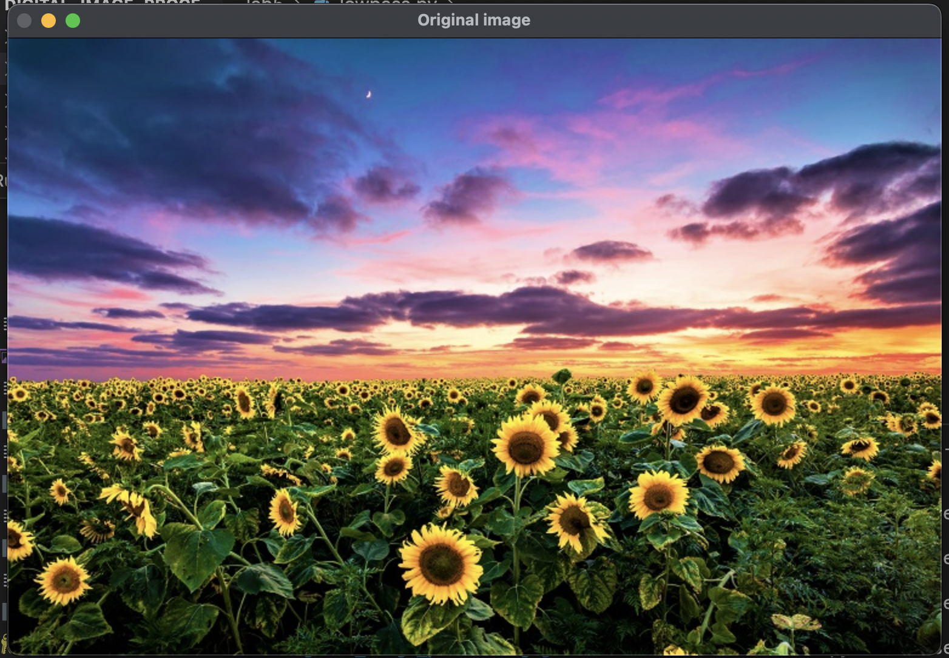
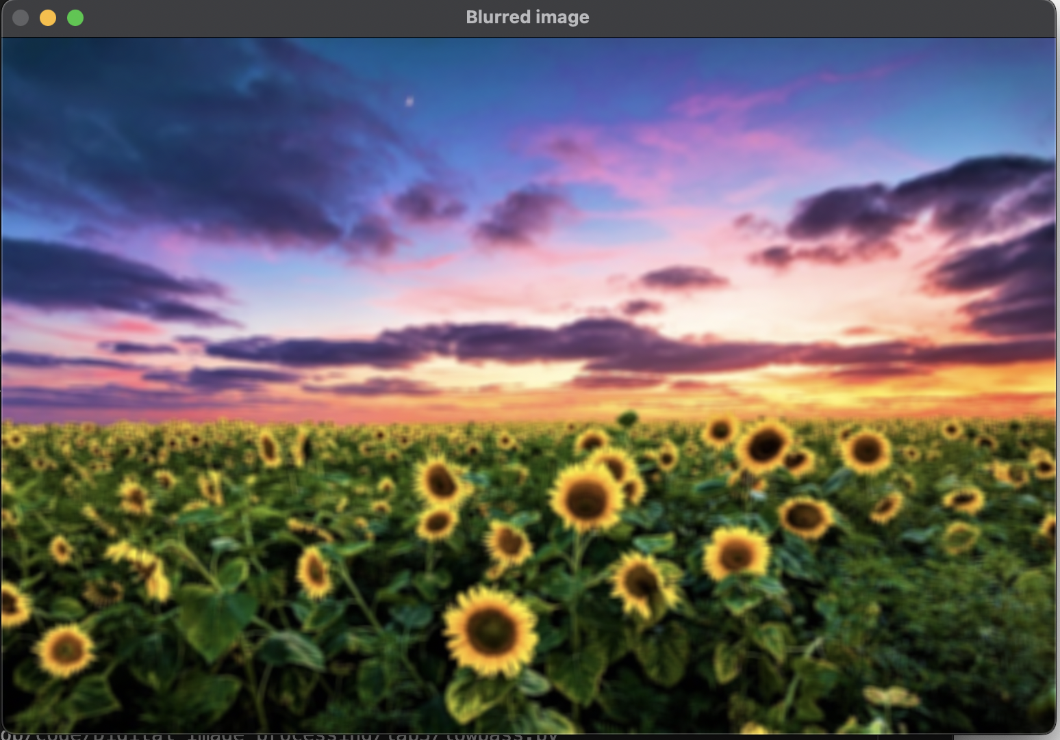
PANTONE® COLOUR OF THE YEAR 2022
OUTPUT-:

Slide 5
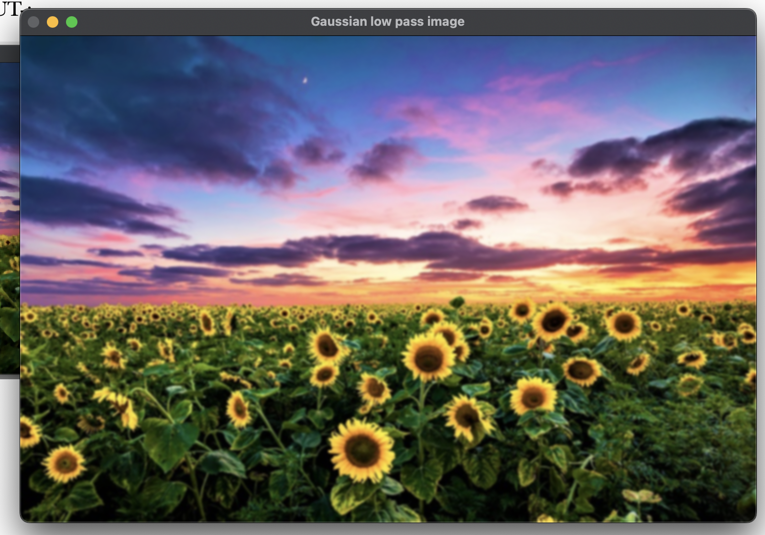
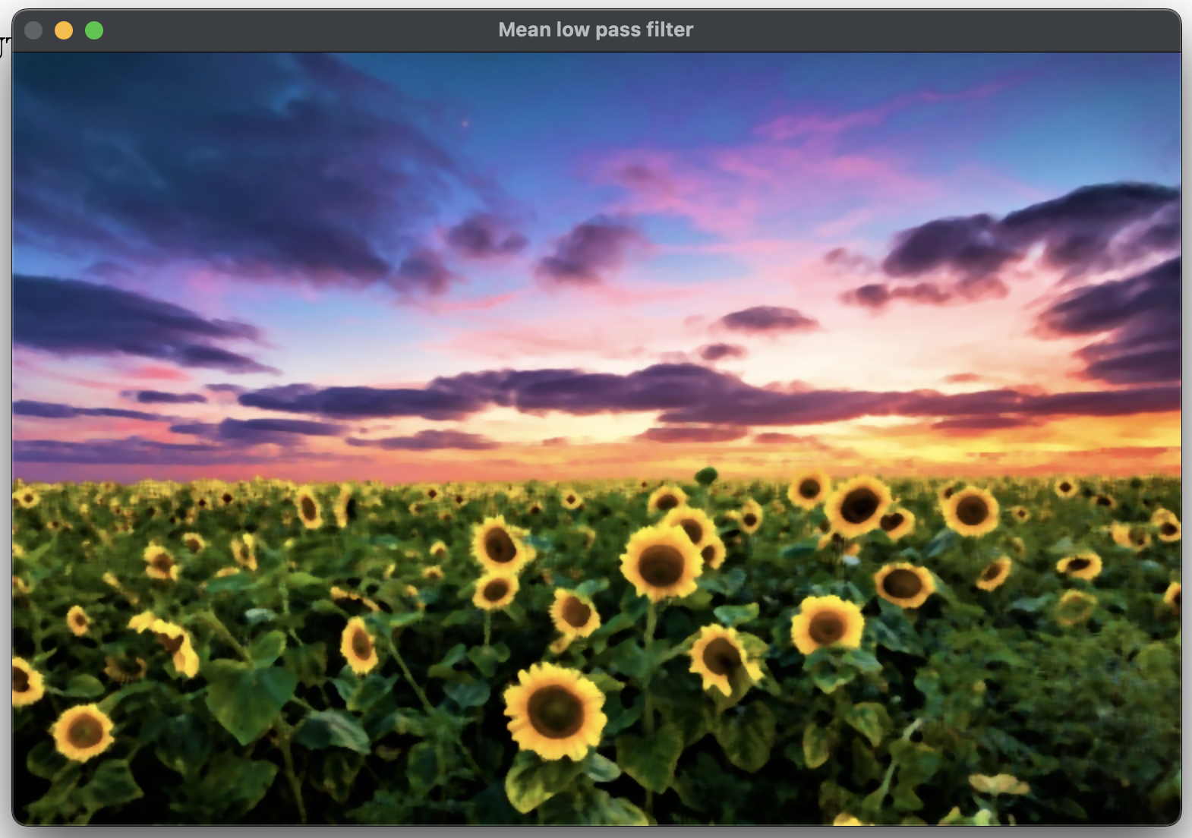
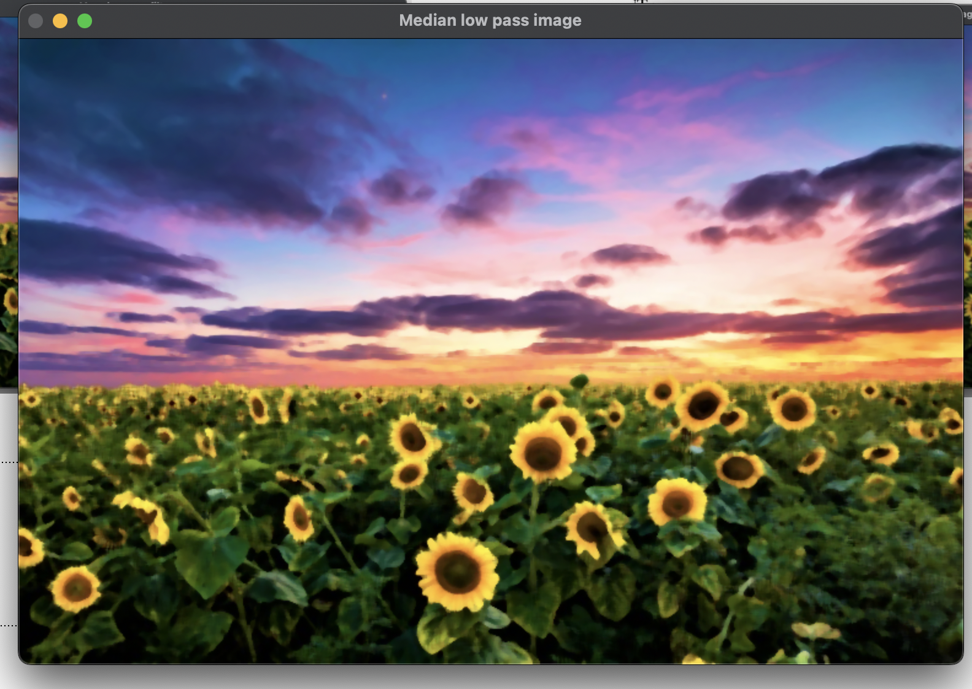
OUTPUT-:

Slide 6
import cv2
img = cv2.imread("wp3013104.jpeg")
img = cv2.resize(img, (680, 520),interpolation=cv2.INTER_CUBIC)
hpf = img - cv2.GaussianBlur(img, (21, 21), 3)+127
cv2.imshow("Original", img)
cv2.waitKey(0)
cv2.destroyAllWindows()
cv2.imshow("High Passed Filter", hpf)
cv2.waitKey(0)
cv2.destroyAllWindows()

Slide 7
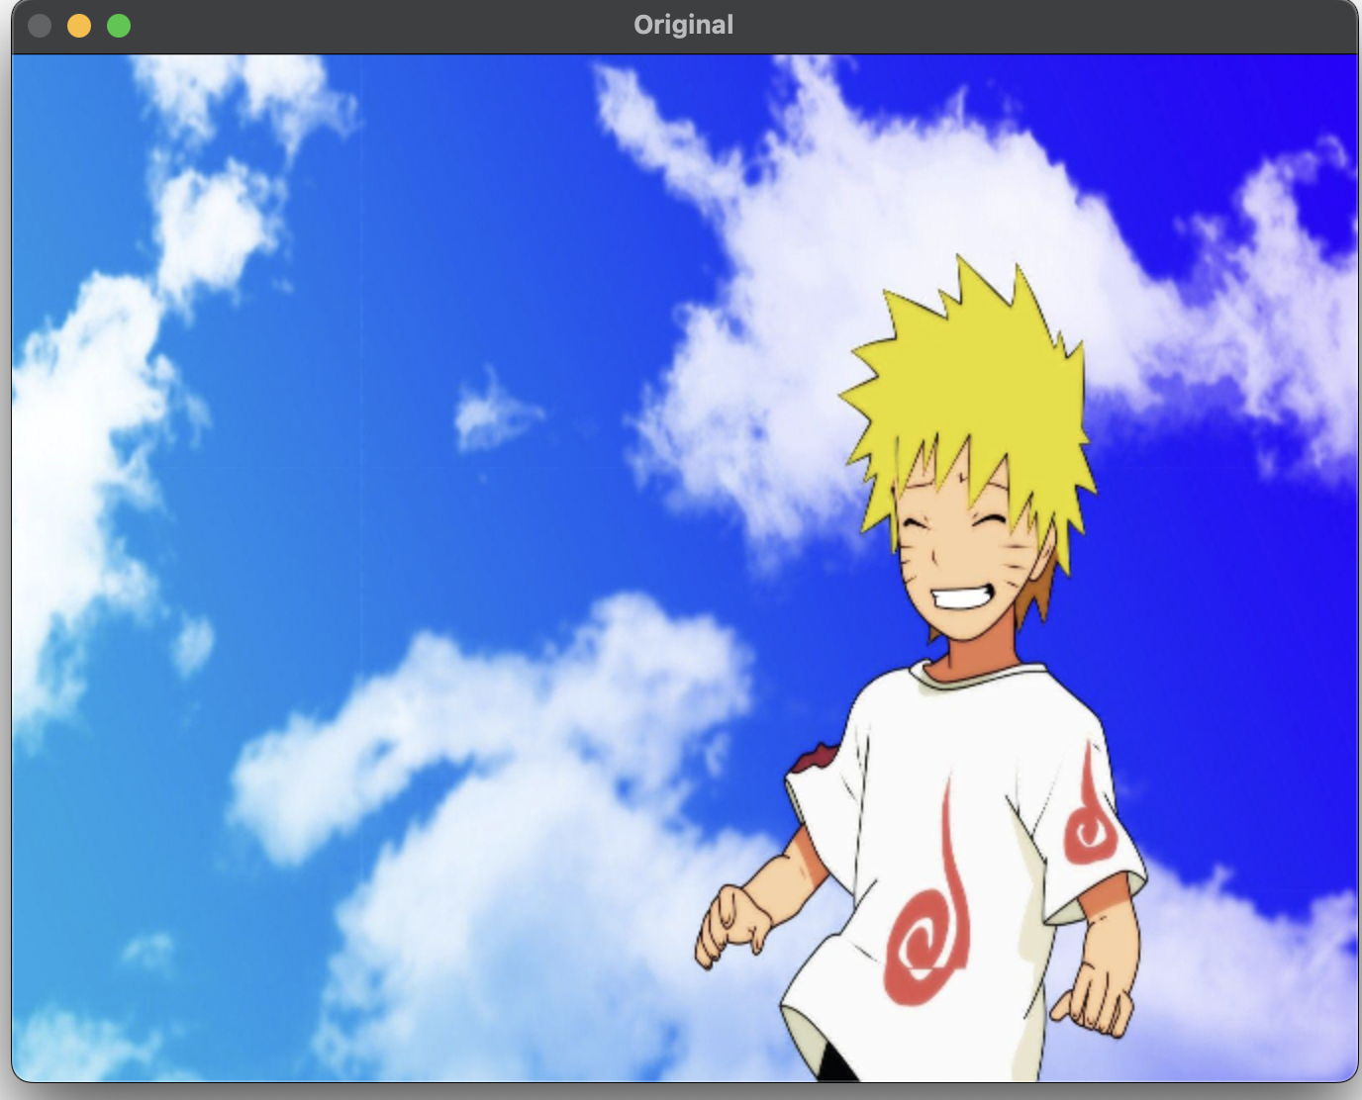
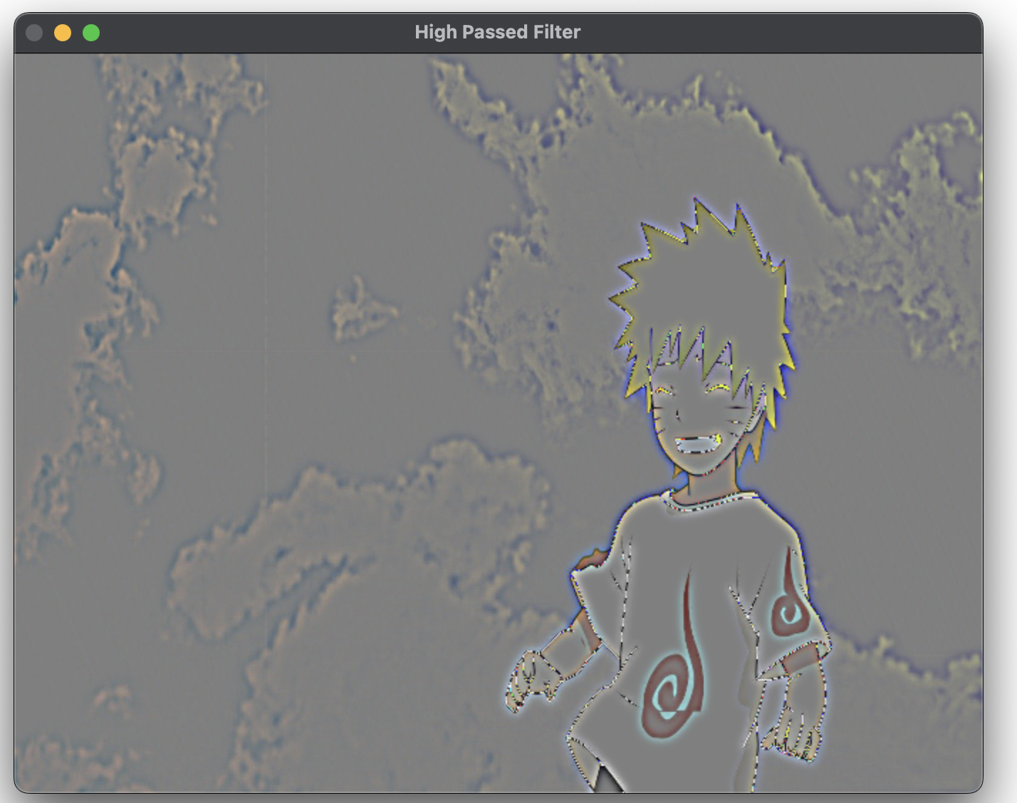
PANTONE® COLOUR OF THE YEAR 2022
OUTPUT-:

Slide 8
PANTONE® COLOUR OF THE YEAR 2022
import cv2
import numpy as np
import matplotlib.pyplot as plt
img = cv2.imread('wp3013104.jpeg')
img = np.float32(img)
img = img/255
rows,cols,dim=img.shape
rh, rl, cutoff = 2.5,0.5,32
imgYCrCb = cv2.cvtColor(img, cv2.COLOR_BGR2YCrCb)
y,cr,cb = cv2.split(imgYCrCb)
y_log = np.log(y+0.01)
y_fft = np.fft.fft2(y_log)
y_fft_shift = np.fft.fftshift(y_fft)

Slide 9
PANTONE® COLOUR OF THE YEAR 2022
DX = cols/cutoff
G = np.ones((rows,cols))
for i in range(rows):
for j in range(cols):
G[i][j]=((rh-rl)*(1-np.exp(-((i-rows/2)**2+(j-cols/2)**2)/(2*DX**2))))+rl
result_filter = G * y_fft_shift
result_interm = np.real(np.fft.ifft2(np.fft.ifftshift(result_filter)))
result = np.exp(result_interm)
cv2.imshow("Original image",img)
cv2.waitKey(0)
cv2.destroyAllWindows()
cv2.imshow("Homomorphic filtering",result)
cv2.waitKey(0)
cv2.destroyAllWindows()

Slide 10
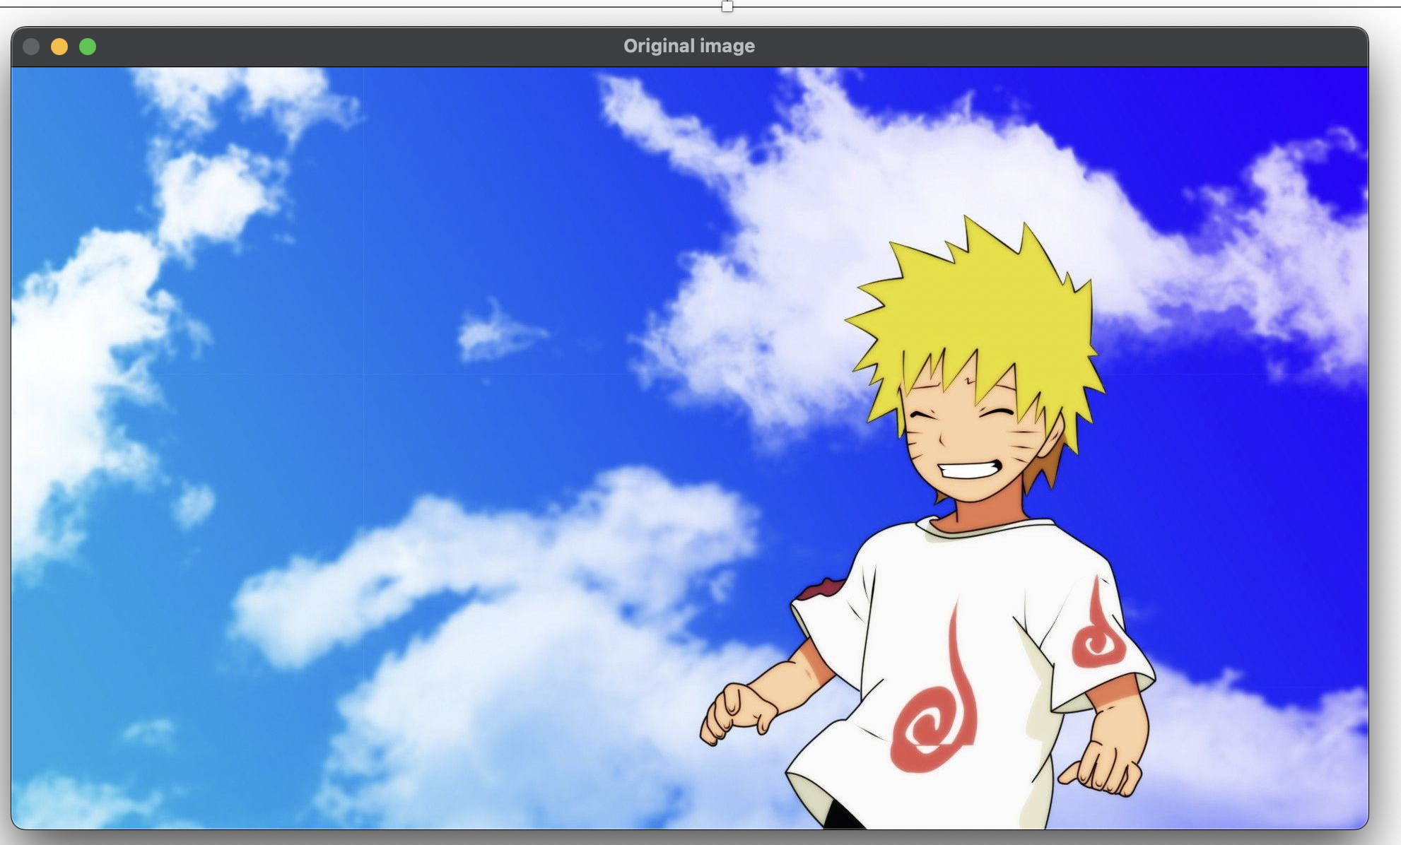
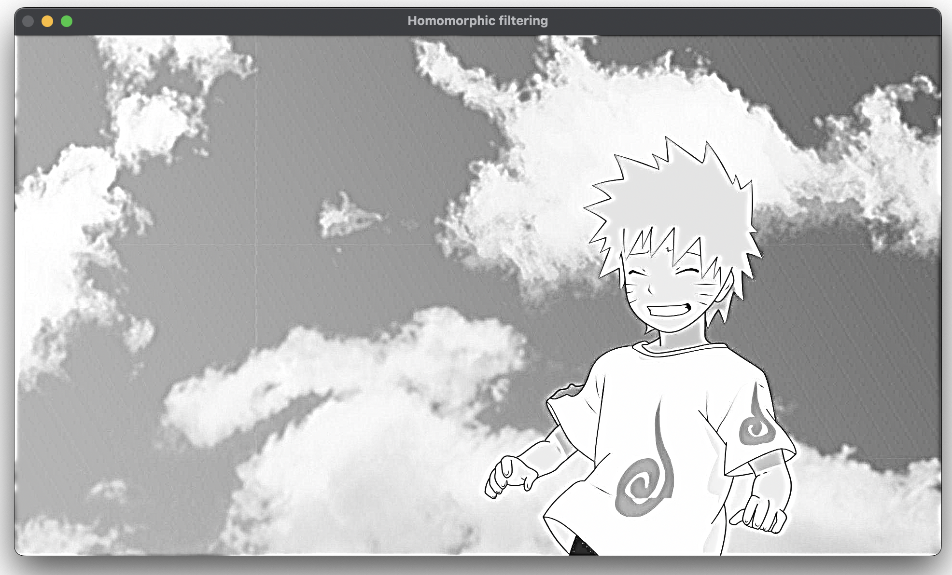
OUTPUT-:

Slide 11
THANK YOU You can find the code at -: https://github.com/Baka-14/Digital_Image_processing

